Slide 1
Cloud Native
NOVEMBER 2017

Slide 2
Agenda
What are Cloud-Native Applications?
Why Cloud-Native Applications Matter?
Characteristics of a Cloud-Native Organization
Cloud-Native Architecture
Cloud Native Introduction

Slide 3
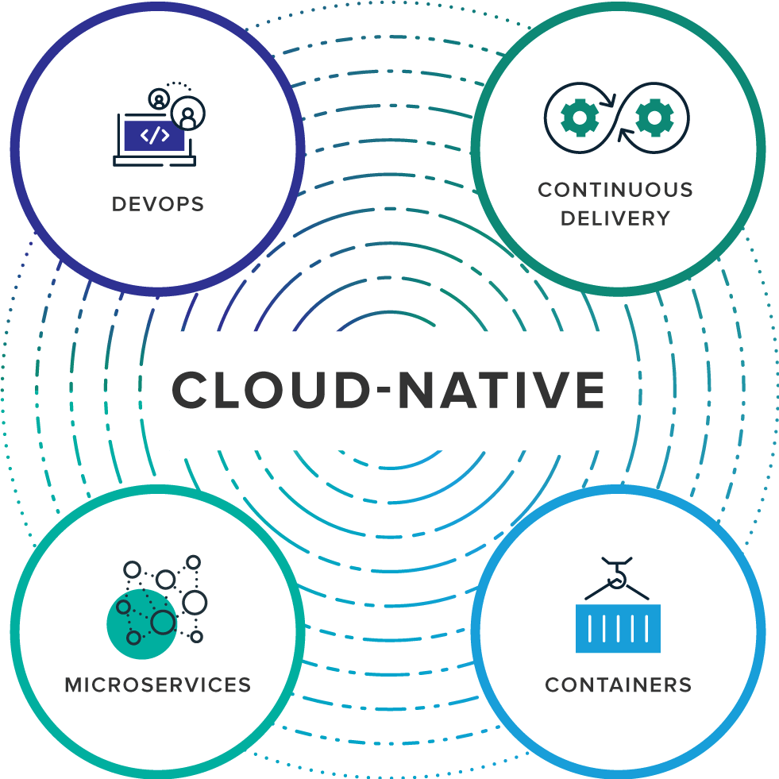
What are Cloud-Native Applications?
collaboration between software developers and IT operations with the goal of constantly delivering high-quality software that solves customer challenges
enabled by Agile product development practices, is all about shipping small batches of software to production constantly, through automation
an architectural approach to developing an application as a collection of small services; each service implements business capabilities, runs in its own process and communicates via HTTP APIs or messaging
offers both efficiency and speed compared with standard virtual machines (VMs)
Notes:
Cloud-native is an approach to building and running applications that fully exploits the advantages of the cloud computing delivery model. Cloud-native is about how applications are created and deployed, not where. While today public cloud impacts the thinking about infrastructure investment for virtually every industry, a cloud-like delivery model isn’t exclusive to public environments. It's appropriate for both public and private clouds. Most important is the ability to offer nearly limitless computing power, on-demand, along with modern data and application services for developers. When companies build and operate applications in a cloud-native fashion, they bring new ideas to market faster and respond sooner to customer demands.
Organizations require a platform for building and operating cloud-native applications and services that automates and integrates the concepts of DevOps, continuous delivery, microservices, and containers.
DevOps is the collaboration between software developers and IT operations with the goal of constantly delivering high-quality software that solves customer challenges. It creates a culture and environment where building, testing and releasing software happens rapidly, frequently, and more consistently.
Continuous Delivery, enabled by Agile product development practices, is all about shipping small batches of software to production constantly, through automation. Continuous delivery makes the act of releasing dull and reliable, so organizations can deliver frequently, at less risk, and get feedback faster from end users.
Microservices is an architectural approach to developing an application as a collection of small services; each service implements business capabilities, runs in its own process and communicates via HTTP APIs or messaging. Each microservice can be deployed, upgraded, scaled, and restarted independent of other services in the application, typically as part of an automated system, enabling frequent updates to live applications without impacting end customers.
Containers offer both efficiency and speed compared with standard virtual machines (VMs). Using operating system (OS)-level virtualization, a single OS instance is dynamically divided among one or more isolated containers, each with a unique writable file system and resource quota. The low overhead of creating and destroying containers combined with the high packing density in a single VM makes containers an ideal compute vehicle for deploying individual microservices.

Slide 4
Cloud-Native Versus Traditional Enterprise Applications
CLOUD-NATIVE APPS
Predictable
OS Abstraction
Right-size capacity
Collaboration
Continuous Delivery
Independent
Automated Scalability
Rapid Recovery
TRADITIONAL ENTERPRISE APPS
Unpredictable
OS Dependent
Over-sized Capacity
Siloed
Waterfall Development
Dependent
Manual Scaling
Slow recovery
Notes:
CLOUD NATIVE APPS
Predictable. Cloud-native applications conform to a framework or “contract” designed to maximize resilience through predictable behaviors. The highly automated, container-driven infrastructure used in cloud platforms drives the way software is written. A good example of such a “contract” is illustrated by the 12 principles first documented as the 12-factor app.
OS abstraction. A cloud-native application architecture lets developers use a platform as a means for abstracting away from underlying infrastructure dependencies. Instead of configuring, patching, and maintaining operating systems, teams focus on their software. The most efficient means of abstraction is a formalized platform, for example, Pivotal Cloud Foundry which is ideal for operating on cloud-based infrastructure such as Google Cloud Platform (GCP), Microsoft Azure, or Amazon Web Services (AWS).
Right-sized capacity. A cloud-native application platform automates infrastructure provisioning and configuration, dynamically allocating and reallocating resources at deploy time based on the ongoing needs of the application. Building on a cloud-native runtime optimizes application lifecycle management, including scaling to meet demand, resource utilization, orchestration across available resources, and recovery from failures to minimize downtime.
Collaborative. Cloud-native facilitates DevOps, a combination of people, process, and tools, resulting in a close collaboration between development and operations functions to speed and smooth the transfer of finished application code into production.
Continuous delivery. IT teams make individual software updates available for release as soon as they are ready. Organizations that release software rapidly get a tighter feedback loop and can respond more effectively to customer needs. Continuous delivery works best with other related approaches including test-driven development and continuous integration.
Independent. Microservices architecture decomposes applications into small, loosely coupled independently operating services. These services map to smaller, independent development teams and make possible frequent, independent updates, scaling, and failover/restart without impacting other services.
Automated scalability. Infrastructure automation at scale eliminates downtime due to human error. Computer automation faces no such challenge, consistently applying the same set of rules across any size of deployment. Cloud-native also goes beyond the ad-hoc automation built on top of traditional virtualization-oriented orchestration. A fully cloud-native architecture is about automating systems, not servers.
Rapid recovery. The container runtime and orchestrator provides a dynamic, high-density virtualization overlay on top of a VM, ideally matched to hosting microservices. Orchestration dynamically manages placement of containers across a cluster of VMs to provide elastic scaling and recovery/restart in the event of app or infrastructure failure.
TRADITIONAL ENTERPRISE APPS
Unpredictable. Traditional applications can’t realize all of the benefits of running on a cloud-native platform due to the unique way each one is architected or developed. This type of application often takes longer to build, is released in big batches, can only scale gradually, and assumes high availability of dependent services.
OS dependent. Traditional application architecture allows developers to build close dependencies between the application and underlying OS, hardware, storage, and backing services. These dependencies make migrating and scaling the application across new infrastructure complex and risky, working against the cloud model.
Over-sized capacity. Traditional IT designs a dedicated, custom infrastructure solution (“snowflake”) for an application, delaying deployment of the application. The solution is often over-sized based on worst-case capacity estimates with little capability to scale beyond to meet demand.
Siloed. Traditional IT operates an over-the-wall handoff of finished application code from developers to operations, which then runs it in production. Organizational priorities take precedence over customer value, resulting in internal conflict, slow and compromised delivery, and poor staff morale.
Waterfall development. IT teams release software periodically, typically weeks or months apart, when code has been built into a release despite the fact that many of the components of the release are ready earlier and have no dependency other than the artificial release vehicle. Features that customers want or need are delayed and the business misses opportunities to compete, win customers, and grow revenue.
Dependent. Monolithic architectures bundle many disparate services into a single deployment package causing unnecessary dependencies between services and leading to a loss of agility during development and deployment.
Manual scaling. Manual infrastructure includes human operators that manually craft and manage server, network, and storage configurations. At scale, operators are slow to correctly diagnose issues and easily fail to correctly implement at scale due to the level of complexity. Hand-crafted automation recipes have the potential to hard-code human errors into the infrastructure.
Slow recovery. VM-based infrastructure is a slow and inefficient foundation for microservice-based applications because individual VMs are slow to startup/shutdown and come with large overhead even before deploying application code to them.

Slide 5
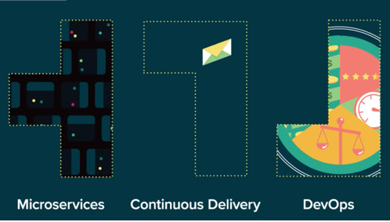
Characteristics of a
Cloud-Native Organization
Microservice architecture
Continuous Delivery
DevOps Culture
Notes:
A microservices architecture means multiple, independent team working to make a system better.
Continuous delivery is a clear, automated path that lets developers rapidly deploy to production environments.
A DevOps culture helps developers and operations work together to deliver shared value to the customer.

Slide 6
Cloud-Native Architecture
WHY
Cloud Computing
New Demands
Being Reactive
Speed & Safety
Notes:
CLOUD COMPUTING
What is cloud computing and what are some of the new demands that were facing? What does it mean to be reactive to these demands?

Slide 7
Cloud Computing
Cloud Computing
Cloud Native Applications
Cloud Native Application Architecture
Cloud Computing
New Demands
Being Reactive
Speed & Safety
WHY
Notes:
CLOUD COMPUTING
What is cloud computing and what are some of the new demands that were facing? What does it mean to be reactive to these demands?
Cloud computing is a model of computing where resources are provided over the network in an on-demand manner, often ephemeral, and independent of any specific physical manifestation. We’re essentially talking about highly distributed systems.
Cloud native applications are applications that are built on the assumption that they’re going to be deployed to a cloud-based operating environment.
Cloud native application architecture refers to patterns that we identify that work well for cloud native applications.

Slide 8
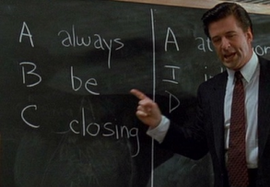
Cloud-era Demands
Competitive landscape
Consumer expectations
Device Diversity and Ubiquity
Scale
Cloud Computing
New Demands
Being Reactive
Speed & Safety
WHY
D
delivering
Notes:
NEW CLOUD-ERA DEMANDS
Having all of this distributed compute power readily available and easily accessible has led to new demands.
For one thing, it has changed the competitive landscape. It has enabled incredible innovation. Small, software-based businesses are constantly introducing new or improved services. They can quickly respond to consumer feedback and behavior, and they are eating market share that has for a long time remained by and large stable and well within the jurisdiction of larger, established enterprises.
Consumer expectations have skyrocketed. The cost of switching from one provider to another is very low, so the ability to deliver innovative, high value, high quality products, incorporate user feedback quickly, and deliver quality service consistently are critical.
We see an incredible diversity in the types of devices that we have to service, whereas before we only needed to account for desktops or laptops and then eventually smartphones and different sorts of tablets, now we have to consider that any “thing” could be a client – televisions, medical equipment, household appliances, wearables, all kinds of sensors - and that diversity and ubiquity is only going to grow. Even with just phones and tablets, the scale we need to accommodate with zero downtime is huge, and that, too, will only continue to grow. Not only do we have an increasing number of devices, but the frequency of requests from any given device is also growing.

Slide 9
Being Reactive
React to Events
React to Load
React to Failure
React to Users
Cloud Computing
New Demands
Being Reactive
Speed & Safety
WHY
Notes:
BEING REACTIVE
React to Events, to Load, to Failure, and to Users. If we have systems that will enable us to react to events and load and failure and users, then we can meet the demands of this new cloud world.
Build systems and software that will enable us to react to these demands.
Steve Jobs said “you can’t engineer innovation, but you can increase the odds of it occurring.”

Slide 10
Speed & Safety
Design for quick recovery
Quick recovery increases risk tolerance
Risk tolerance enables innovation
Cloud Computing
New Demands
Being Reactive
Speed & Safety
WHY
Notes:
SPEED & SAFETY
Design for quick recovery, Quick recovery increases risk tolerance, Risk tolerance enables innovation
Think about the relationship between speed and safety. Think about what would empower you to be able to drive a car fast. If you trust the wheel and the brakes to respond when you need them, you can go faster, maybe take sharper turns or explore new terrain.
If we have a system that is reactive to load to failure, a system that is tolerant to risk, then we will be able to move more quickly. Will be able to get new ideas to market faster and more often. And that same speed will empower us to take more business risks, because as quickly as we put a new idea out there, we can very quickly replace it with something better based on user feedback. This combination of speed and safety are going to help us deliver better product.
The truth is we can no longer afford to move slowly. We can’t take six months or a year to get a product out to market only to discover that someone else beat us there or the idea doesn’t work as well as we thought and then take another six months or a year to try something different. We don’t have the luxury of waiting.

Slide 11
Cloud-Native Architecture
WHY
WHAT
Cloud Computing
New Demands
Being Reactive
Speed & Safety
Reactive Design
12 Factor Apps
Microservices
Design Patterns
Notes:
Why and How cloud computing has created new demands and expectations. What are some of the new principles and methodologies for building software, including 12 factor apps and microservices.

Slide 12
Reactive Design
React to Events → Event-Driven
React to Load → Scalable
React to Failure → Resilient
React to Users → Responsive
Reactive Design
12 Factor Apps
Microservices
Design Patterns
WHAT
Notes:
Going back to the idea of being able to react to new demands, from a system design perspective, we need a system that is:
Event-Driven, so that we can respond to events
Scalable or elastic, so that we can respond to load
Resilient, so we can react to failure, and
Responsive, so we can respond to users quickly, whether its end users or other systems using our APIs

Slide 13
The Twelve Factor App
http://12factor.net
I. Codebase
One codebase tracked in revision control, many deploys
II. Dependencies
Explicitly declare and isolate dependencies
III. Config
Store config in the environment
IV. Backing services
Treat backing services as attached resources
V. Build, release, run
Strictly separate build and run stages
VI. Processes
Execute the app as one or more stateless processes
VII. Port binding
Export services via port binding
VIII. Concurrency
Scale out via the process model
IX. Disposability
Maximize robustness with fast startup and graceful shutdown
X. Dev/prod parity
Keep development, staging, and production as similar as possible
XI. Logs
Treat logs as event streams
XII. Admin processes
Run admin/management tasks as one-off processes
Notes:
12 factor app is a methodology that tells us HOW to build software in a way that takes advantage of modern cloud platforms. It defines a clean contract with the underlying cloud platform.
By adhering to this contract, we define a clean separation of responsibility between the app and the underlying system. We decouple the app from system concerns, which simplifies our apps and gives us greater portability across execution environments, greater consistency between development and production, greater agility and scalability, and the capability for continuous deployment.

Slide 14
The Twelve Factor App
http://12factor.net
I. Codebase
One codebase tracked in revision control, many deploys
II. Dependencies
Explicitly declare and isolate dependencies
III. Config
Store config in the environment
IV. Backing services
Treat backing services as attached resources
V. Build, release, run
Strictly separate build and run stages
VI. Processes
Execute the app as one or more stateless processes
VII. Port binding
Export services via port binding
VIII. Concurrency
Scale out via the process model
IX. Disposability
Maximize robustness with fast startup and graceful shutdown
X. Dev/prod parity
Keep development, staging, and production as similar as possible
XI. Logs
Treat logs as event streams
XII. Admin processes
Run admin/management tasks as one-off processes
Notes:
Just to highlight a few, the first one says that every app should have a separate codebase, a separate code repository. If you have one application that is composed of several repositories, then what you have is a distributed system, not a 12 factor app. Each of those code repos composing your distributed system could be 12 factor, but the larger application is a distributed system, not an app. On the flip side, if you have multiple apps sharing a codebase, that’s also a violation of 12 factor. You could have libraries that are used by different apps but at the codebase level you should be able to take that app and deploy it independently all the way through production without impacting any other app codebase. This is a way to encourage loose coupling that sets us up for the ability to do continuous deployment.
In terms of dependencies, a 12 factor app decouples the choice of programming framework from the underling platform. If your app explicitly declares all of its dependencies rather than relying on the system to provide language-specific libraries or packages, then you can write your app in any language of your choice. Every app needs to explicitly declare all of its dependencies, aiming to be self-contained, self-sufficient and complete in its definition as a unit of deployable, runnable work. A clean separation of concerns between app and underlying platform that gives us greater choice and portability.
Another pillar of 12 factor apps is strict separation between the code base and any configuration that needs to change cross deployments. Moreover, configuration should be made available through mechanisms that are agnostic to the programming framework, a good example being environment variables or a centralized config repository accessible to all kinds of apps.
There’s also a contract for loose coupling between the app and any kind of backing service that it uses, whether the backing service is a local database or queue, or a third-party resource like Amazon S3, New Relic, or Google Maps, they’re all treated in the same loosely coupled way as attached resources, decoupled from the code. This gives the administrator of the backing service the ability to detach and attach a service instance without requiring any code changes.
12 factor also warns us not to rely on local memory or disk for persistence. In a horizontally scaled platform, we assume failure will happen, so we have to allow the underlying cloud platform to replace processes in case of failure. Any state that needs to be persisted should be stored in a backing service so that we can keep our apps stateless.
12 Factor also tells us to treat logs as event streams. The app is responsible for emitting logging information, but it should not concern itself with the managing, storing, or routing log files. That is a system concerns and the responsibility of the execution environment. This approach also ensures apps are not using local disk to store log files, which as we just saw in the last factor, would make our app instance stateful and violate 12 factor. What’s great is that with logs provided as event streams, we don’t have to ssh all over the place to collect our logs anymore. Instead, our logs are streamed to us over the network. Makes troubleshooting much easier.
Overall, besides providing guidance on how to write individual apps, 12 factor informs us about what we need from the underlying platform and what we might want from development tools. We’ll touch on those points again later in this presentation.

Slide 15
What is a Microservice?
A Modern Approach to Software Architecture
Reactive Design
12 Factor Apps
Microservices
Design Patterns
WHAT
If services have to be updated together,
they’re not loosely coupled!
Loosely coupled service oriented architecture with bounded contexts
Adrian Cockcroft
If you have to know about surrounding services,
you don’t have a bounded context
Notes:
A microservice is the result of a modern architectural approach that emphasizes decoupling complex functionality into smaller, independent (micro)services. Each microservice consists of simpler functionality with fewer, focused concerns that can only be accessed via well defined interfaces (i.e. callers cannot rely on knowledge about underlying implementation details). A collection of microservices jointly comprise an application, and each microservice is independently deployed, scaled, managed. Effectively deploying and operating Microservices heavily relies upon automation (e.g., CI/CD, container orchestration, etc.).
Microservices refers to an architectural approach that independent teams use to prioritize the continuous delivery of single-purpose services. The microservices model is the opposite of traditional monolithic software which consists of tightly integrated modules that ship infrequently and have to scale as a single unit. Although the monolithic approach works fine for some organizations and some applications, microservices is becoming popular with companies that need greater agility and scalability.
The concept of a microservice builds on the idea of a 12-factor app. If we stick to 12 factor, then each microservice will run as a discrete and isolated unit of work. It is discrete in the sense that it focuses on a small set of responsibilities (think back to 12 factors guiding us to have one codebase per app), and isolated because it is a self-sufficient runnable artifact, an inherently distributed entity (remember 12 factor helps us write apps that are decoupled from the execution environment with explicitly declared dependencies, externalized configuration, attached backing services, etc).
One way to evaluate our microservices is to ask:
Can I update each service without having to update other services, and
Can each service fulfill its responsibility without relying on surrounding services
If we can answer yes to both of those questions, then we have well-defined microservices with loose coupling and bounded contexts.
-----------------------
Auxiliary notes on defining the bounded context:
Model services from the domain
Domain driven design
Services implement a contract
Services use models matching their local view of the domain
Where models diverge is a good clue to a boundary
This is where domain knowledge has the biggest impact
Spend your resources here

Slide 16
Why Now? Shorter Cycle Times
Converging Trends
Software is Eating the World
4. Cannot deploy and manage quickly
Solved
Prerequisite
Business
Trend
DevOps
Next Problem
3. Cannot provision on-demand, elastic compute capacity quickly.
Solved
Containers
Prerequisite
Enables
Enterprise
Initiative
Digital Transformation
Cloud Native Software
Next Problem
2. Cannot build/test quickly
Solved
CI/CD
Pipeline
Prerequisite
Next Problem
Develop More Software, Better/ Faster
1. Monolith complexity slows rapid, incremental development
Operational
Need
Solved
Microservices
Technical
Challenges
Technology
Trends

Slide 17
Monolith vs. Microservice
Microservice
Microservice
Microservice
Microservice
Microservice
Microservice
Microservice
Microservice
Interface
B
Queues, Pub-Sub and other messaging paradigms enable asynchronous processing and independent scaling.
A
Publish-Subscribe
(Pub-Sub)
Queue
A
Microservice
Microservice
B
C
C
D
E
Microservice
Microservice
Microservice
First-in First-out
(FIFO)
Queue
Microservice
F
Microservice
G
H
E
D
Independent state
Microservice
Microservice
Explicit interface boundary
F
Microservice
Microservice
Microservice
Microservice
Microservice
Microservice
Independently scalable, e.g. Microservice H may have 3 container instances
Microservice
G
H

Slide 18
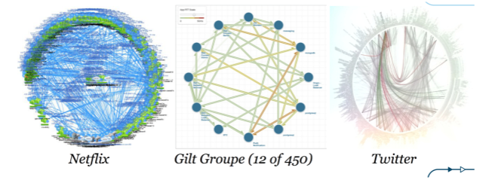
Microservices Pioneers
Reactive Design
12 Factor Apps
Microservices
Design Patterns
WHAT
Notes:
So we know what were moving away from. What models can we look to as examples of something to emulate? Netflix, The Gilt Groupe, and Twitter are examples of some of the recognized leaders in pioneering micro service architecture successfully. Their proof positive of the kind of innovation the scalability and the resiliency that we can achieve using micro services and a more practical level we can learn from patterns that have enabled these companies to employ micro service architecture successfully and in some cases directly benefit from code that they have made available to the open source community. I’ll give a few examples later on the presentation.
So these images can be inspirational, but they also give us some insight into some new challenges we might face in managing highly distributed micro service architectures.

Slide 19
Who Moved My Complexity?
Microservices are individually simple
Complexity is transferred to the ecosystem
Reactive Design
12 Factor Apps
Microservices
Design Patterns
WHAT
Notes:
So we know what were moving away from. What models can we look to as examples of something to emulate? Netflix, The Gilt Groupe, and Twitter are examples of some of the recognized leaders in pioneering micro service architecture successfully. Their proof positive of the kind of innovation the scalability and the resiliency that we can achieve using micro services and a more practical level we can learn from patterns that have enabled these companies to employ micro service architecture successfully and in some cases directly benefit from code that they have made available to the open source community. I’ll give a few examples later on the presentation.
So these images can be inspirational, but they also give us some insight into some new challenges we might face in managing highly distributed micro service architectures.

Slide 20
Challenges in a Distributed System
Configuration management
Registration and discovery
Routing and load balancing
Fault tolerance and isolation
Aggregation and transformation
Monitoring and distributed tracing
Process management
Reactive Design
12 Factor Apps
Microservices
Design Patterns
WHAT
Notes:
What are some of the challenges we face with distributed systems?
Let’s go through each of these and talk about a design pattern that we can apply to address each particular challenge.

Slide 21
Design Patterns & Automation to the Rescue!
Config
Server
Service
Registry
Circuit Breaker Dashboard
Tracing Dashboard
Client
UI
(JavaScript)
UI Server
Proxy
Edge
Service
Backend Service
Circuit Breaker
Load Balancing
Backend Service
Backend Service
Notes:
Let’s use this as a boilerplate architecture to focus on the challenges and possible solutions. In this case, if we trace the middle row of services from left to right, we have a set of applications that will call each other to fulfill a request from the client. The top row, inside of the dotted rectangle, shows a set of services, for configuration, registration, and a couple of dashboards, that are shared by the applications. On the bottom row we see that there are some additional services that are also being used by the applications.

Slide 22
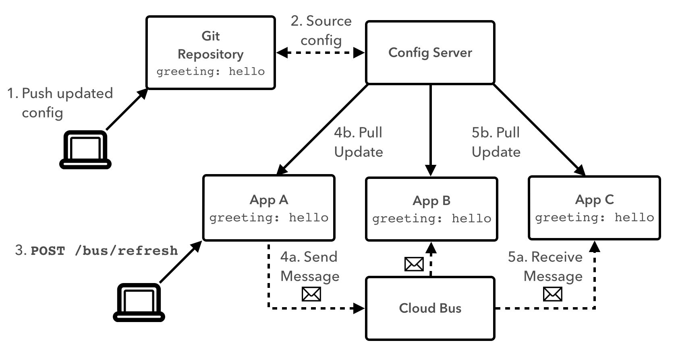
Configuration Server
Notes:
We know from 12 factor that we want to extract configuration that will be different between dev, test, and prod, but where do we put it and how do we manage updates across a distributed web of applications?
We can use a configuration server accessible to all applications to manage configuration.
Using a version control system, like git or subversion, as a backing for the config server provides additional benefits: we can maintain an auditable history of values over time, we can correlate the values the were used at any point in time, and we can direct different versions of the app to use different versions of configuration values.
Using a cloud bus allows us to propagate changes across the distributed system. We can use a REST endpoint to trigger an application to refresh its configuration, and that app would take care of publishing the change to the shared bus.

Slide 23
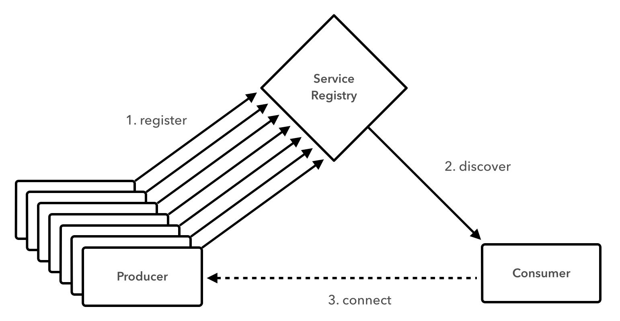
Registration and Discovery Server
Notes:
We can use a service registry so that instances of producer applications can register their endpoints, and consumer applications can obtain those endpoints. The concept is similar to UDDI, but UDDI implementations were coupled to WSDL and SOA stacks. A cloud-appropriate registry server doesn’t impose a particular spec on the producer or consumer, so it is more appropriate for polyglot environments.

Slide 24
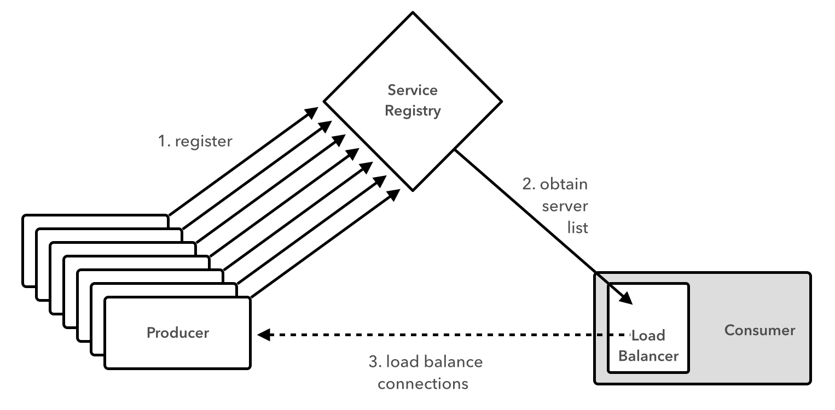
Client-Side Load Balancing
Notes:
We can move load balancing to the client. Here we see that a consumer application can obtain a full list of endpoints for a particular consumer from the registry, rather than hitting the registry every time it needs to call the producer. This way, the consumer can choose its preferred load balancing algorithm, whether it’s round robin, random, or weighted based on performance, and if it finds the endpoints become outdate, it can refresh the list from the registry. This model reduces hops to the registry or through a router.

Slide 25
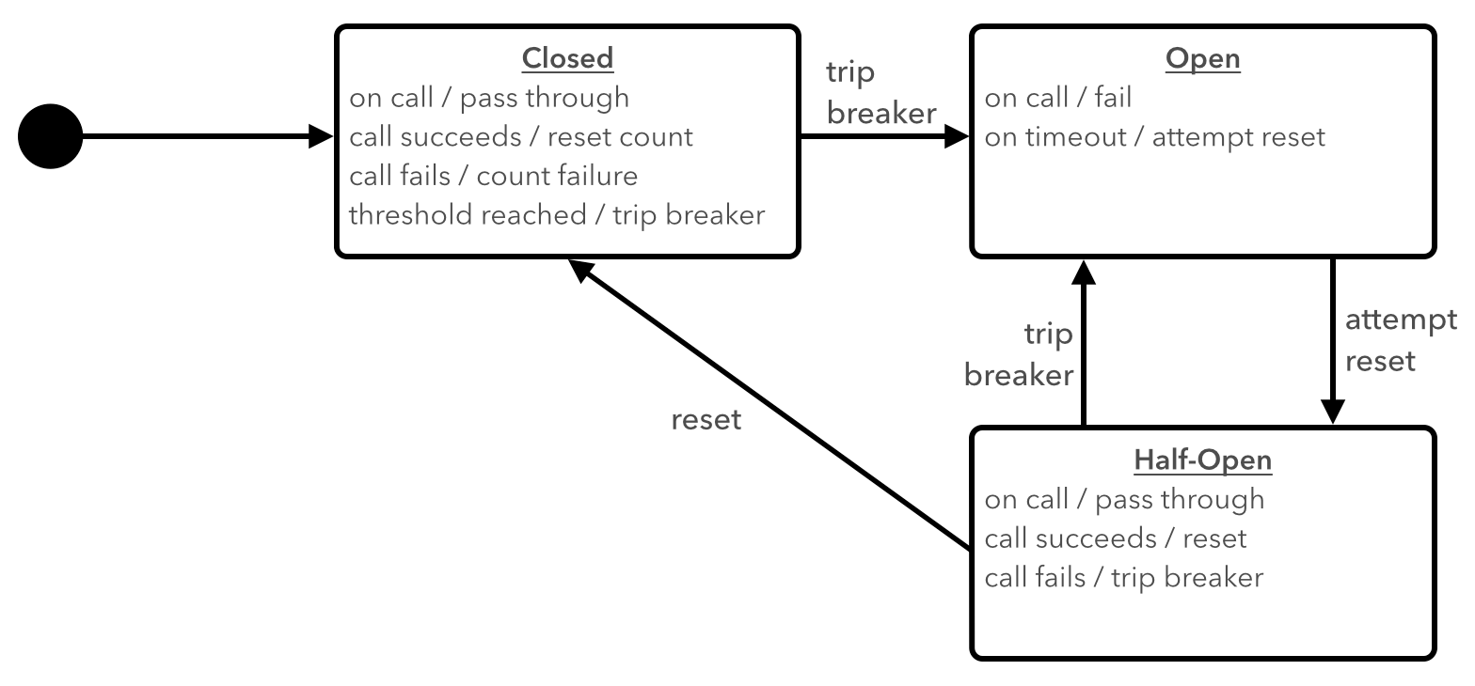
Circuit Breaker
Notes:
The circuit breaker pattern introduces the idea of a fallback action that can be taken when the “happy path” fails. Similar to an electric circuit breaker, the circuit breaker trips upon failure, or when a certain threshold of failure is exceeded. When the circuit breaker is open, the fallback action becomes the default path. The concept of a half-open state means that the happy path is periodically attempted, so that the system can automatically revert to the happy path as default when the cause of failure has been remediated.
We can add a circuit breaker dashboard to get a comprehensive view of the state of all breakers defined in the system.

Slide 26
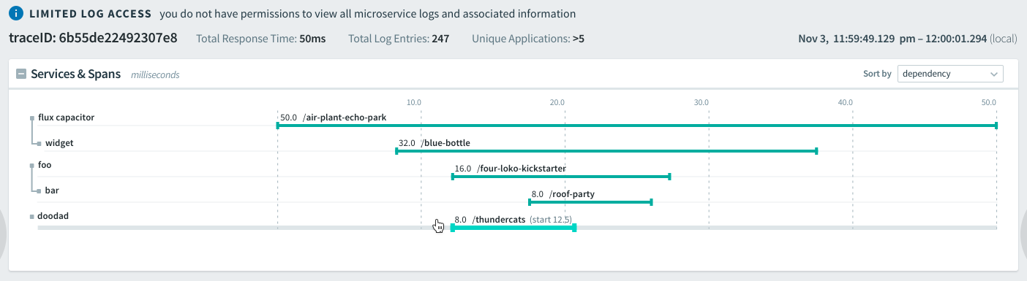
Distributed Tracing
Notes:
With distributed tracing, we assign a unique span id to every user request we receive. That id is passed to the next application that is called, as the parent id, so it can serve to correlate the transaction from the second application to the first. This pattern is followed throughout the life of the transaction, and if we think about a user request as a tre, where processing could follow multiple branches of applications, we can correlate the logging from any application back to the root of the tree using the parent and span ids.
To this we can add a dashboard to add visualization to this distributed tracing.

Slide 27
API Gateway - Edge Service
Edge App
For Desktop
Worker
Apps
Edge App
For Smartphone
Worker
Apps
Worker
Apps
Worker
Apps
Edge App
for IOT Device
Edge App
for Client X
Notes:
We can use edge services to handle the aggregation and transformation needed for each client type. This way we can also be respectful of bandwidth and battery usage on clients and serve back a response that contains only the data each client needs with a minimum number of hops between our application and the client.

Slide 28
Cloud-Native Architecture
WHY
WHAT
HOW
Cloud Computing
New Demands
Being Reactive
Speed & Safety
Reactive Design
12 Factor Apps
Microservices
Design Patterns
Tools
Platform
Process and Culture
Notes:
What are some of the tools we can use to implement cloud-native architecture, and some organizational aspects to keep in mind

Slide 29

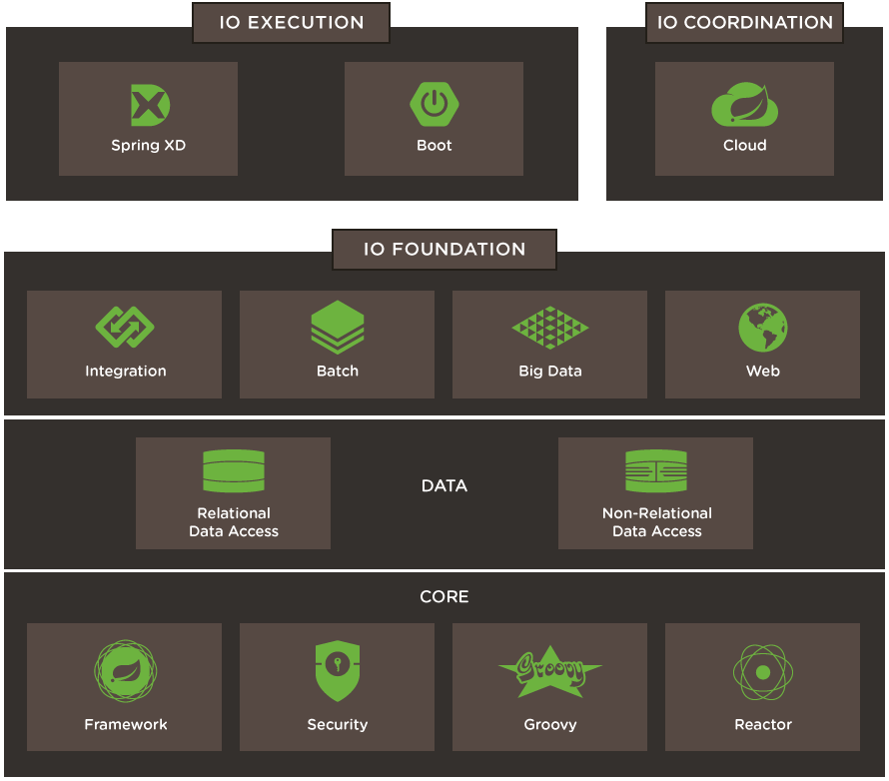
Spring IO
Spring Boot
How to build an app
Opinionated
Convention over configuration
Production ready
Ops friendly
Self contained
Health and metrics
External configuration\
Spring Cloud
Cloud-Native pieces
Version configuration
Service registry and discovery
Routing / load balancing
Circuit breakers
Spring Core
Notes:
So we know what were moving away from. What models can we look to as examples of something to emulate? Netflix, The Gilt Groupe, and Twitter are examples of some of the recognized leaders in pioneering micro service architecture successfully. Their proof positive of the kind of innovation the scalability and the resiliency that we can achieve using micro services and a more practical level we can learn from patterns that have enabled these companies to employ micro service architecture successfully and in some cases directly benefit from code that they have made available to the open source community. I’ll give a few examples later on the presentation.
So these images can be inspirational, but they also give us some insight into some new challenges we might face in managing highly distributed micro service architectures.

Slide 30

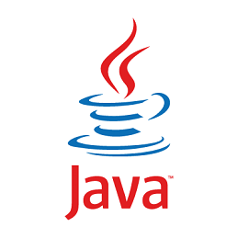
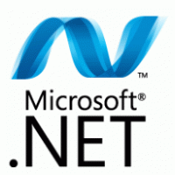
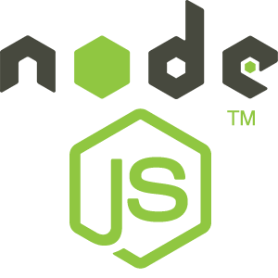
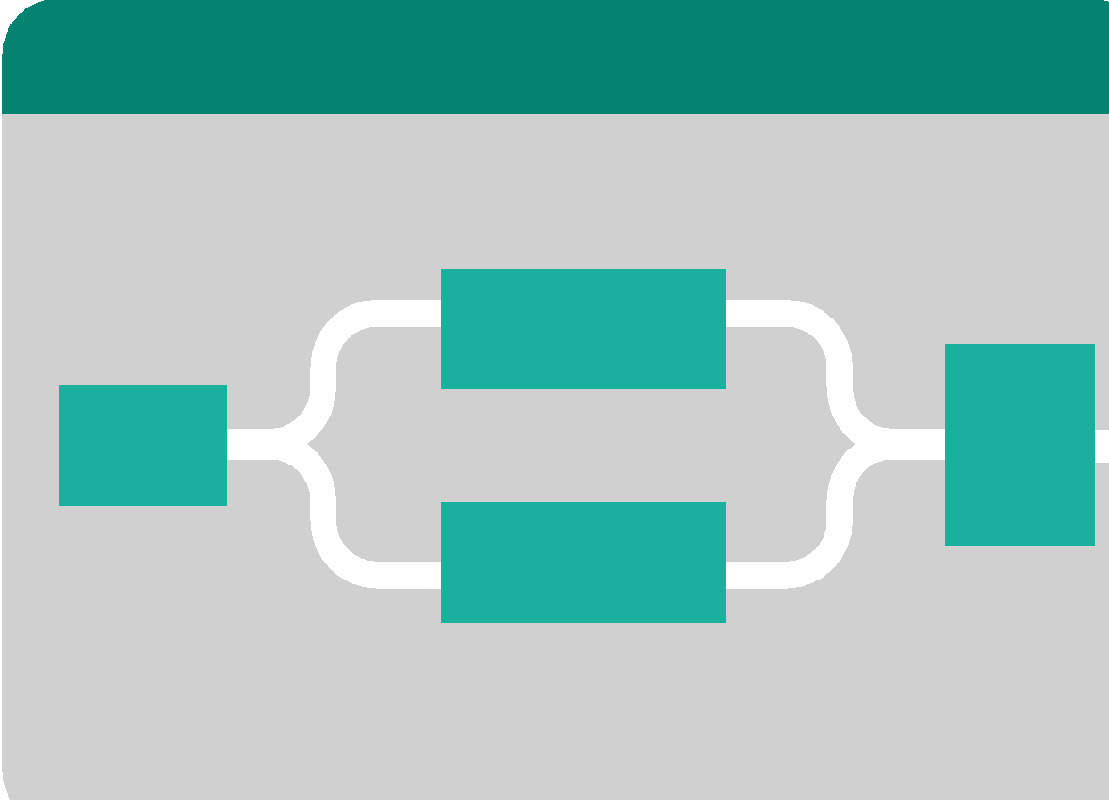

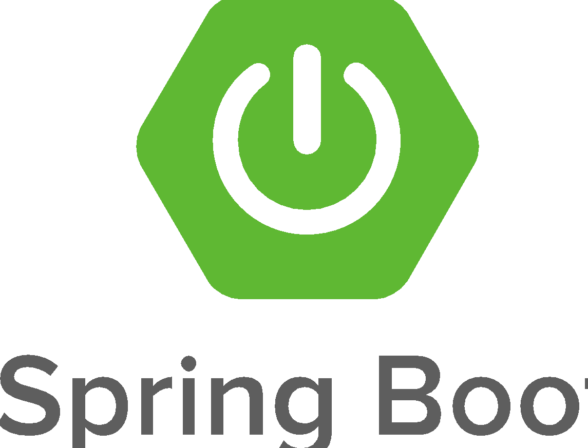
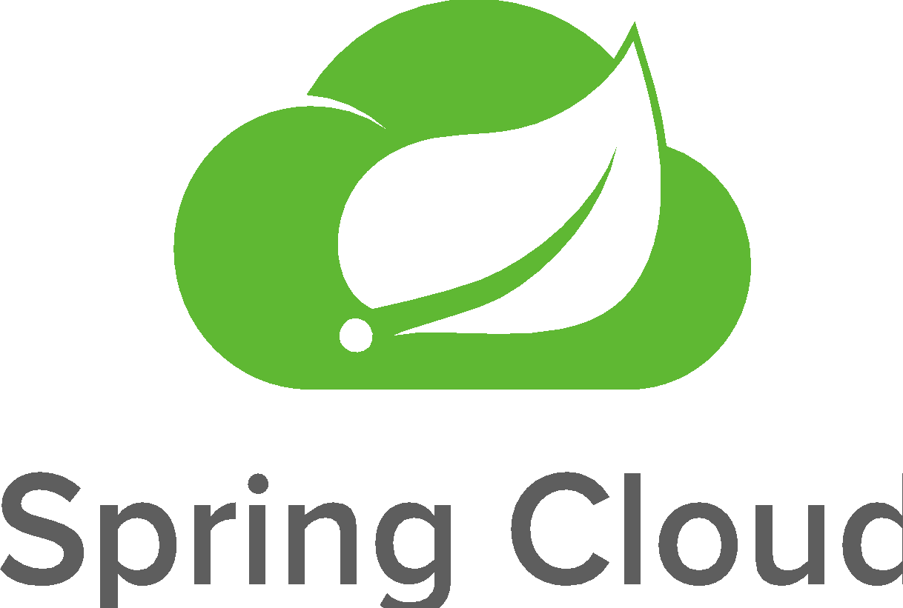
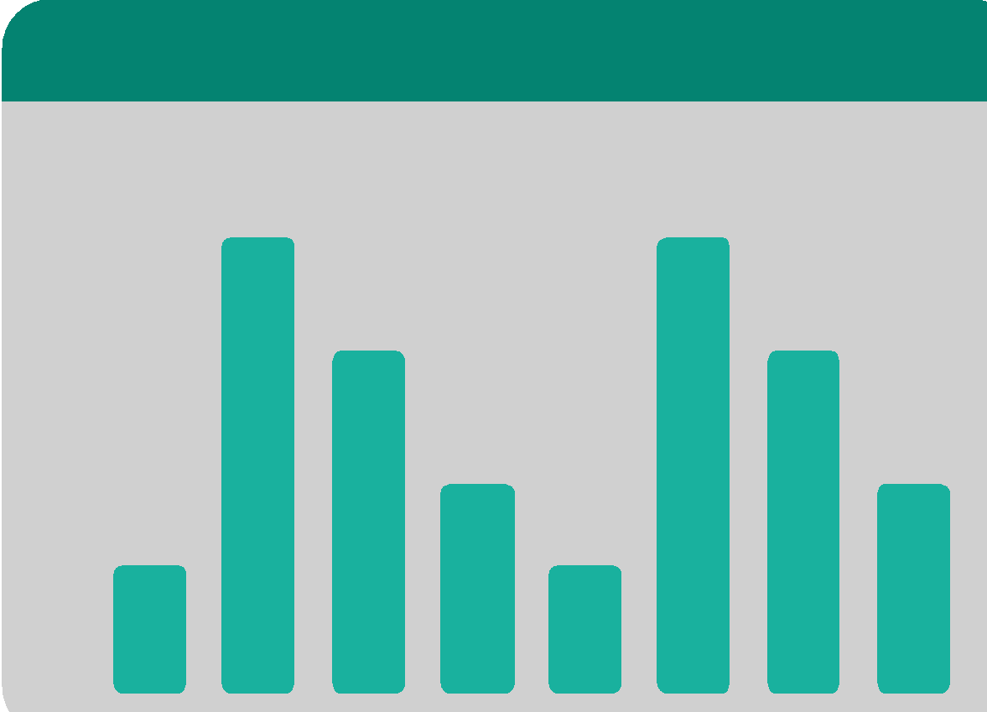
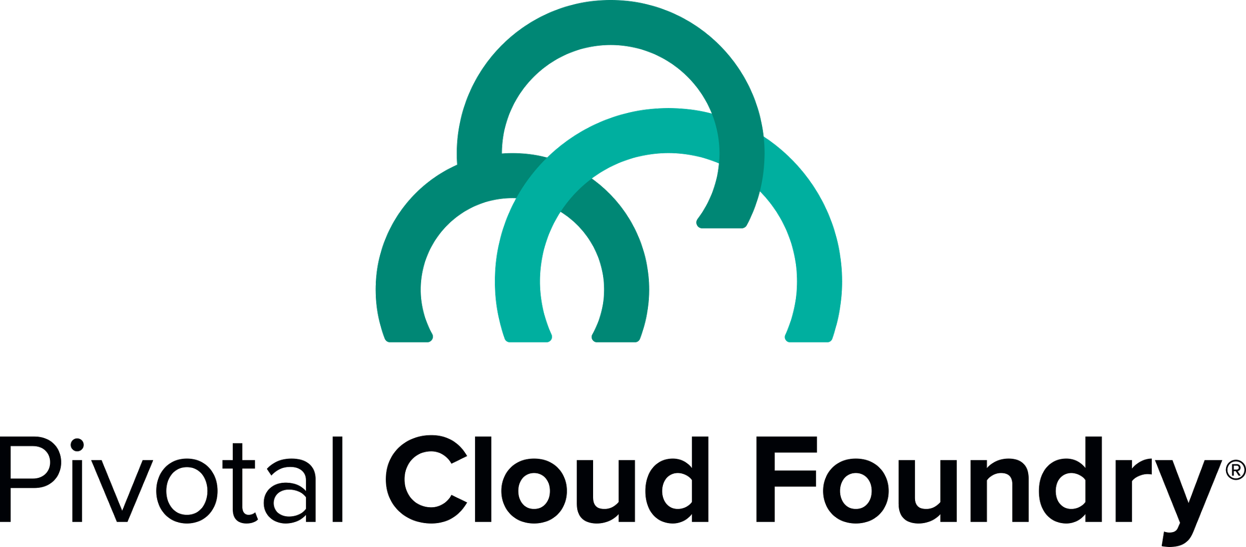
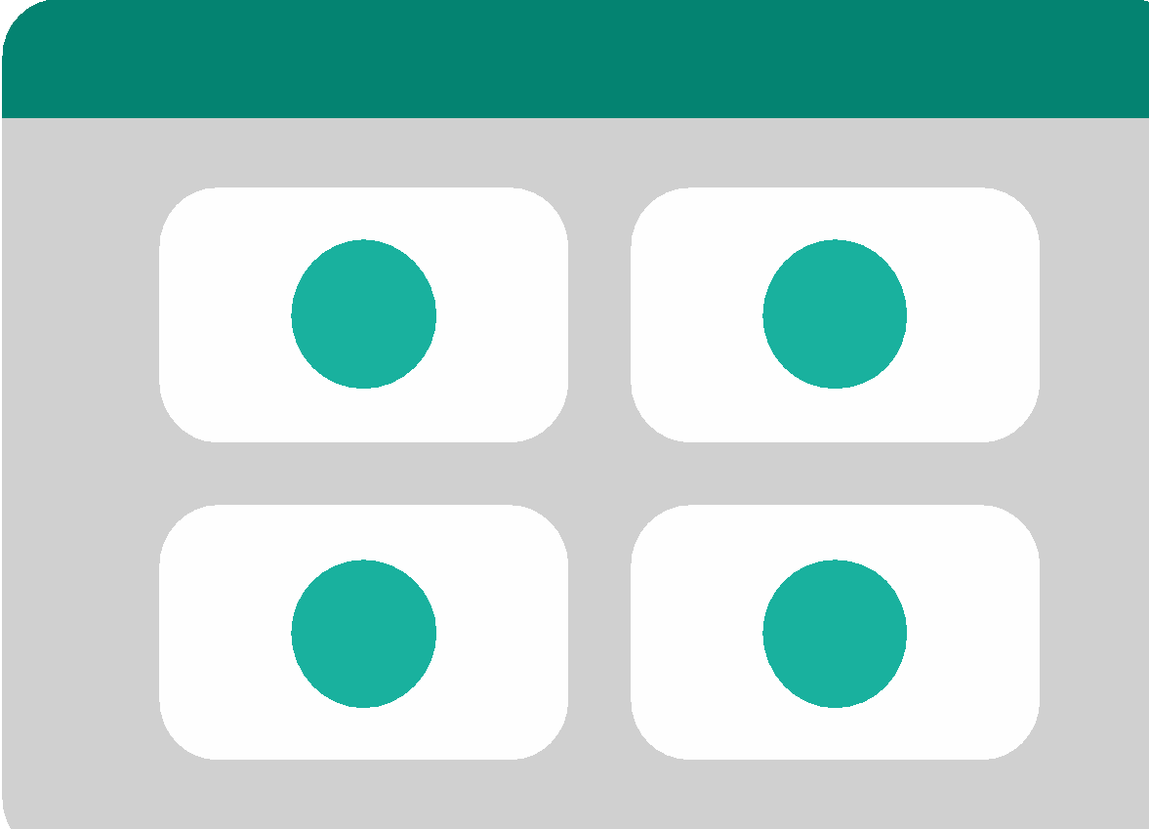

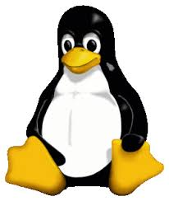
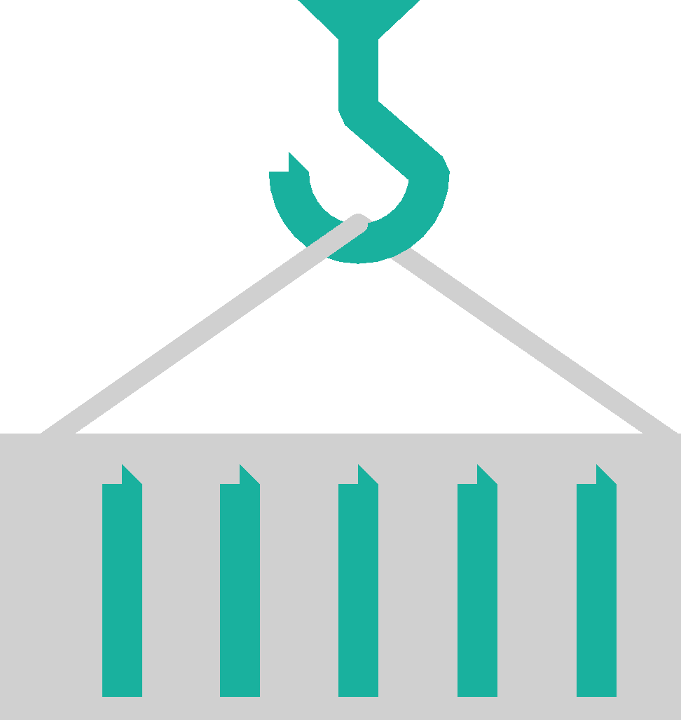
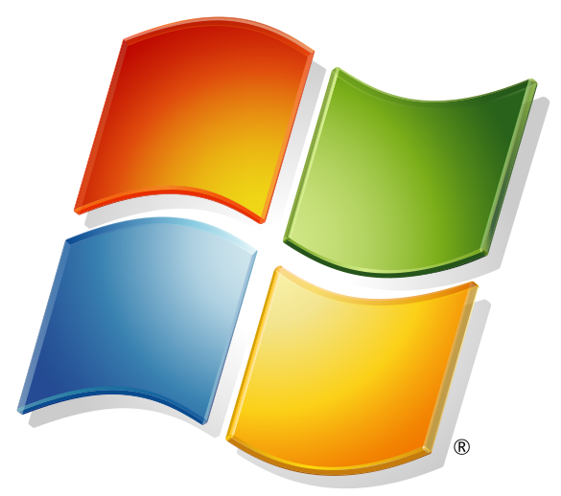
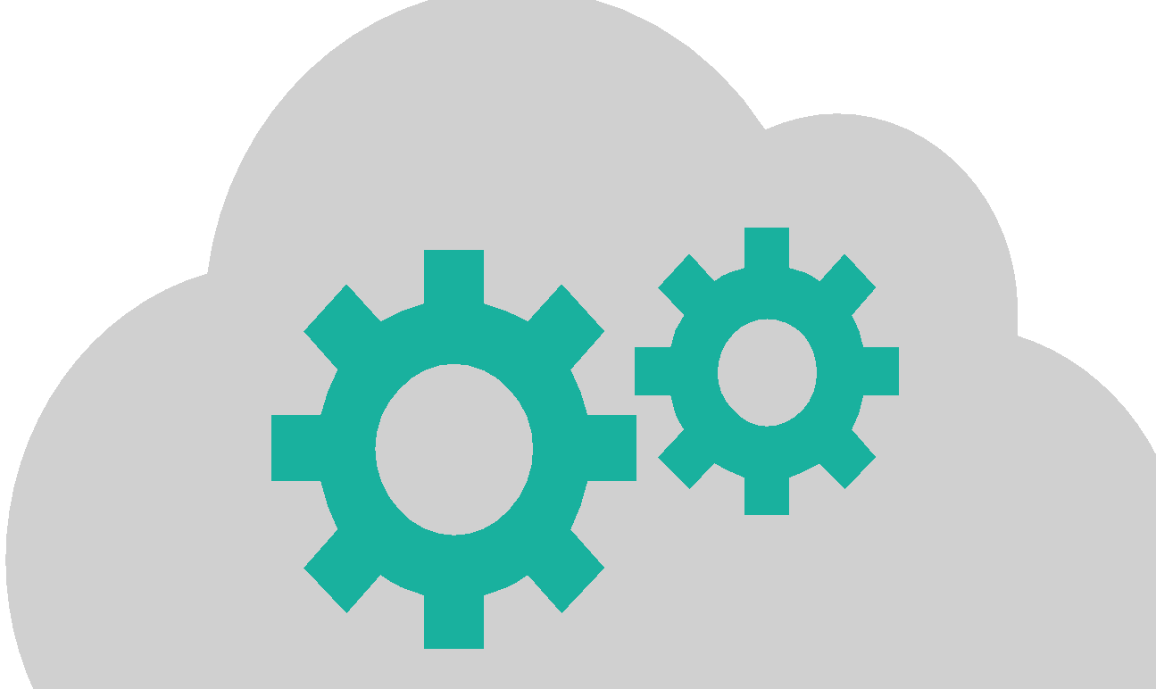
DEVELOPMENT
OPERATIONS
Multiple
Languages
App Deployment
& Management
CI/CD Tools,
ID, Security
Microservices
Support
Health, Metrics,
Patching
Availability
Services
Marketplace
Native
User Provided
Partner
Visibility &
Administration
Apps & Platform
Dashboards
Operating
System
Container Orchestration
Cloud API
Notes:
Pivotal’s vision is to provide a full solution - a platform that allows agile teams to iterate, incorporating the best-of-breed technologies in the industry and best-practices in software engineering and release management.
The PCF platform allows Ops team to
Radically Improve Developer Velocity by getting them the right tools and leveraging existing expertise. We have
Support for many langs
Optimized for Cloud Native applications so developers can quickly stand up microservices, Includes battle-tested Netflix OSS integrations
Easy access to Services
Natively managed services like SSO, MySQL, partner services like AppDynamics, New Relic for monitoring, user provided services like Oracle DB, so enterprises can leverage the data they already have
Purpose built for Day 2 Ops.
Everything to deploy app is available. CI/CD tools, authentication
Once its deployed, everything is there to manage the availability of the app like metrics, health management, scaling etc.
Dashboards for holistic view across apps and Ops
World class container orchestration with zero human intervention in individual machines through app lifecycle
You get industry standard Linux containers, optimized for speed. OS management for Linux stacks and support Windows stack for .NET applications.
Built around Multicloud primitives, no cloud specific features.
We’ve seen customers struggle with piecing together the various tools themselves which can be error prone and inconsistent, because the linkages between the various tools is done manually and each product represents its own source of truth. Ops teams are unnecessarily stretched thin managing the individual pieces.
A more automated solution - one that stretches from the infrastructure all the way to the application framework, rather than ad-hoc automation
An opinionated platform that imposes strict contracts between it and the infrastructure layer, and between itself and the applications and services it supports ,
Is essential so your teams are focused on what brings most value to the company.

Slide 31
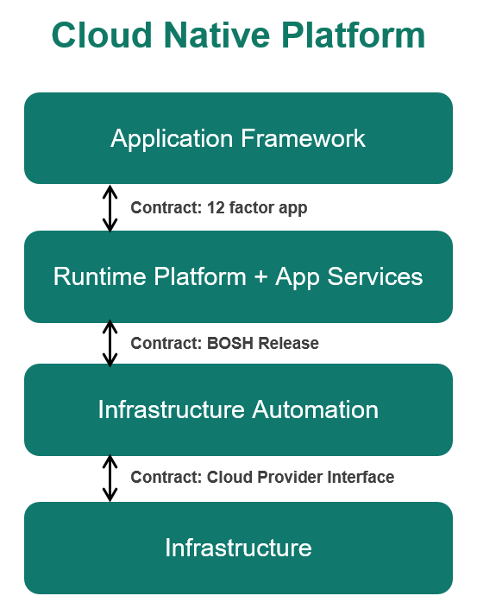
Structured Automation
Groundwork for devops
Self-service
Rapid, automated provisioning
Predictability and consistency, not ad-hoc
Visibility (monitoring & metrics)
Continuous delivery on Day 2
Notes:
With structured automation, we can ensure that the execution environment fulfills its end of the 12 factor contract. The platform should automate provisioning of resources, monitor the health of applications and replace them if they fail, aggregate the log streams from applications… By providing predictable and consistent automation, we can eliminate the workflows and handoffs between development and operations.

Slide 32
The Journey: Technology
Provide the right tools
Platform, design pattern foundations, continuous delivery…
Start small
Right-size for your needs
For migrations, don’t boil the ocean
Target applications that:
Have high business/competitive impact
Need to scale or change frequently
Notes:
What is the journey to cloud native look like?
To begin with, make the necessary tools available to your developers and operators. You need a cloud native platform, and you want to provide the necessary tools and training to enable your developers to implement the design patterns that will ensure long-term success.
Start small and focus on your actual needs. Don’t over-engineer solutions, try to keep things simple and right sized. Finally in terms of the applications to target for implementation on a cloudy platform, choose the ones that would benefit most from agility and innovation, That can add most value to your business, or those that need to scale or change frequently.

Slide 33
The Journey: Culture & Organization
Small, cross-functional teams
Products, not projects
Test-driven development
Short iterations
Transparency and visibility
Notes:
In terms of culture and organization, create small, cross functional teams that own products rather than projects. Teams that will own the products throughout their life cycle until they are retired from production. No more throwing things over the wall and hoping they don’t crack. With test driven development we set ourselves up for greater levels of automation and, hence, greater risk tolerance and continuous deployment. Test driven development also helps us approach our application design from the point of view of the user, and can be helpful in defining how we break down an application into individual microservices. With short iterations we can incorporate user feedback more quickly and more frequently, which is critical to innovation and meeting customer expectations. And finally maintain transparency and visibility at all levels.

Slide 34

Q&A

Slide 35


Notes:
From Silicon Valley…

Slide 36
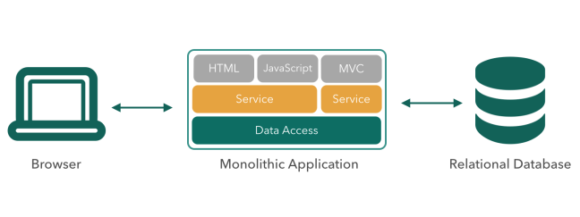
Design Patterns
Not Monoliths
Reactive Design
12 Factor Apps
Microservices
Design Patterns
WHAT
Notes:
We’re moving away from monolithic software and towards a distributed system of services.
Just to clarify, when we talk about monoliths, there’s a continuum between monoliths and service oriented architecture and microservice architecture and most enterprises are somewhere along the continuum. Very old software tends to be truly monolithic where the code is a one codebase in its entirety very much intertwined and interdependent, but most enterprises that have made significant strides towards service oriented architecture and have achieved loose coupling at the logical level but often still deploy as monoliths, meaning they package of a bunch of services and deploy them as a single artifact, so they don’t have the ability to update a single service without redeploying other code or to scale a certain service independently of others. These deployed monoliths are also generally dependent on the target application container or execution environment for dependencies, so they’re not inherently distributed entities that align well to a cloud environment. All of the things together mean that continuous deployment, failure isolation, and a clean contract with the cloud execution environment are still out of reach.
This doesn’t mean that there’s no place for a monolith. Monoliths are still often easier to code, so they’re very useful for initial brainstorming of ideas. However, as an application matures and grows, if new functionality continues to be added to a monolith we will eventually lose transparency and visibility into how that monolith works and what the interdependencies are. On the other hand if, as the system grows, we mature into a microservice model, the fact that microservices are composed of discrete units of work communicating over the network will make the system more transparent and understandable and, in the long-term, more resilient, flexible and manageable.

Slide 37
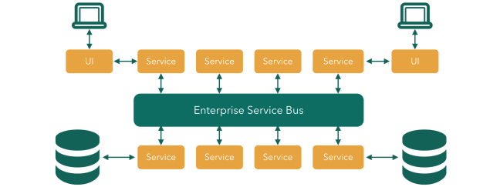
Design Patterns
Not ESB-Centric SOA
Reactive Design
12 Factor Apps
Microservices
Design Patterns
WHAT
Notes:
We’re also moving away from ESB-centric architecture.
ESB’s don’t work well in a cloud environment. There’s a lot of configuration that’s built into them which again, going back to 12 factors, is something we want to avoid. ESB’s also encourage canonical data models that are rigorous and require a lot of up-front cross-functional decision-making. Change, such as adding a new field to a data structure, is often very disruptive with ESBs because it impacts many integration flows. They are also essentially silos, often requiring significant technical expertise to configure and manage, and we want to move toward independent teams creating services that can be deployed freely and the clean contract we saw with 12 factor between our applications and the execution environment.
-------------------------------------
Read more:
http://insights.wired.com/profiles/blogs/why-buses-don-t-fly-in-the-cloud-thoughts-on-esbs#ixzz3y6y8eTFI

Slide 38
Disadvantages of Monoliths
Poor definition or maintenance of module boundaries can allow dependent modules (A, B, C) to write code relying on implementation details of other modules (D). Thus, changes in one module (D) can force (unnecessary) code changes and testing in dependent modules (A, B, C). Also, a small individual module change forces the overhead of a full release – it cannot be tested released independently. Finally, implementation technology (e.g. java) for one module cannot be changed to another (e.g. node.js) because all modules are deployed and run together.
Thus, each product release where multiple modules are undergoing enhancement may result in significant amplification of overhead work to synchronize changes, thereby slowing down releases.
A
Development
Friction
B
D
C
Original
change
Overhead
synchronization
work
Increased usage of a particular module (A) of a monolithic application forces the entire app (with all modules) to be replicated to handle additional load. This results in unnecessary replication of modules with low load leading to unnecessary resource consumption (e.g. memory).
Also, failure in one module can result in the entire application becoming unavailable since all modules run together.
A
Module
Deployment
Friction
Dependency

